Slide 1


Life Expectancy
Regression Analysis
Sowmya Chavali
DSC – 630

Slide 2
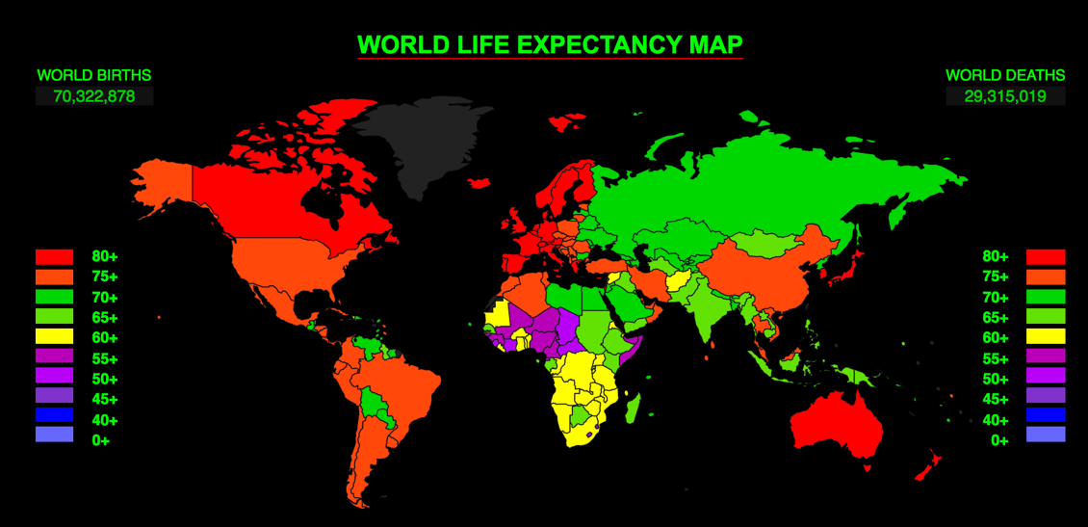
Life Expectancy
Life expectancy is based on an estimate of the average age that members of a particular population group will be when they die.
Determinants
Socioeconomic Reasons
Demographic Changes
Availability of Health Care resources
Cancer and Cardiovascular diseases

Slide 3
Problem Statement
Building a predictive model which helps improve life expectancy by working on how each factor influence longevity.
Questions to address
Do people from developed nations live longer?
Do rich countries have better Environmental Performance Index (EPI) ?
Countries health care expenditure impact on life expectancy

Slide 4
Data
Features
Birth Rate
Target
Life Expectancy
Population
Area
Environmental Performance Index (EPI)
Gross Domestic Product (GDP)
Health Expenditure
Heart Disease Rate
Cancer Rate
Stroke Rate
Data Source
The Demographic , Socio-economic indicators and current life expectancy numbers data is sourced from Wikipedia.
The disease information is sourced worldlifeexpectancy data.
Cross-country data between 2018 and
2019.
Assumptions
Country level average
Combined male & female

Slide 5
Data Preparation
Scraping the relevant data
Null Checks and Data correction
Identifying Outliers
Feature Selection
Merging Data

Slide 6
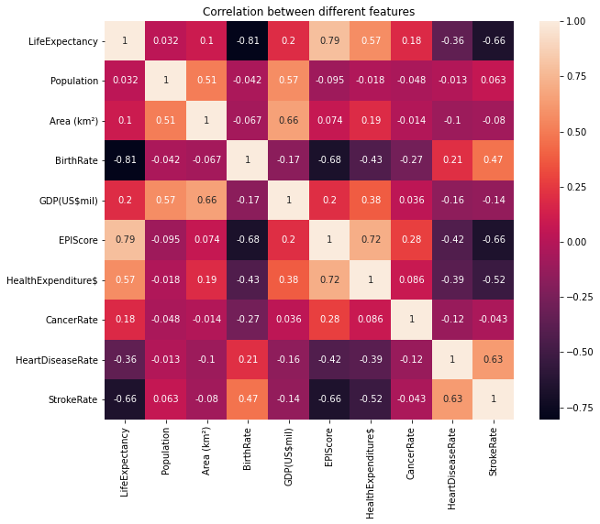
Correlation between features
Correlation between features and target

Slide 7
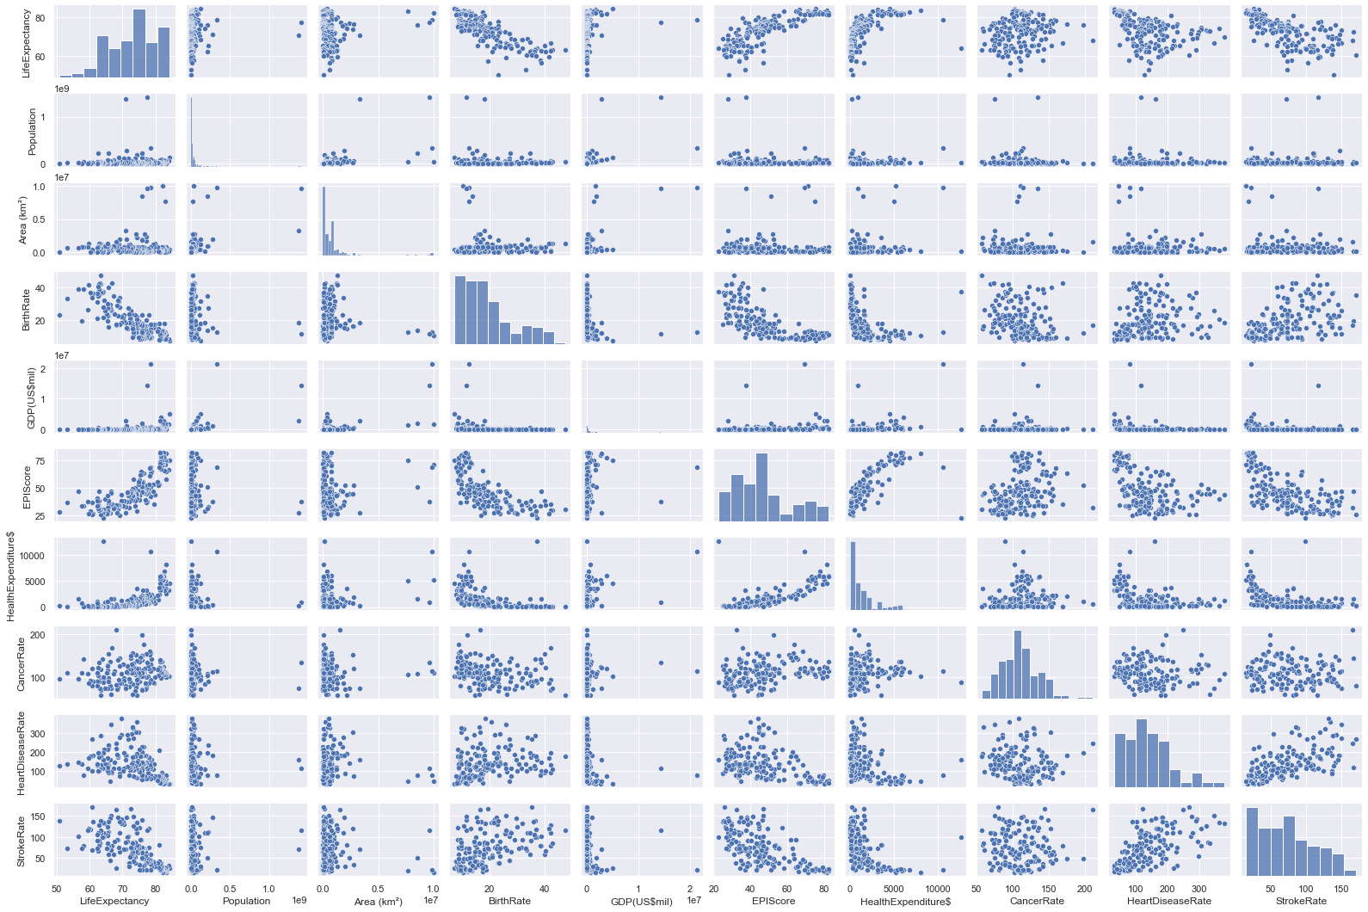
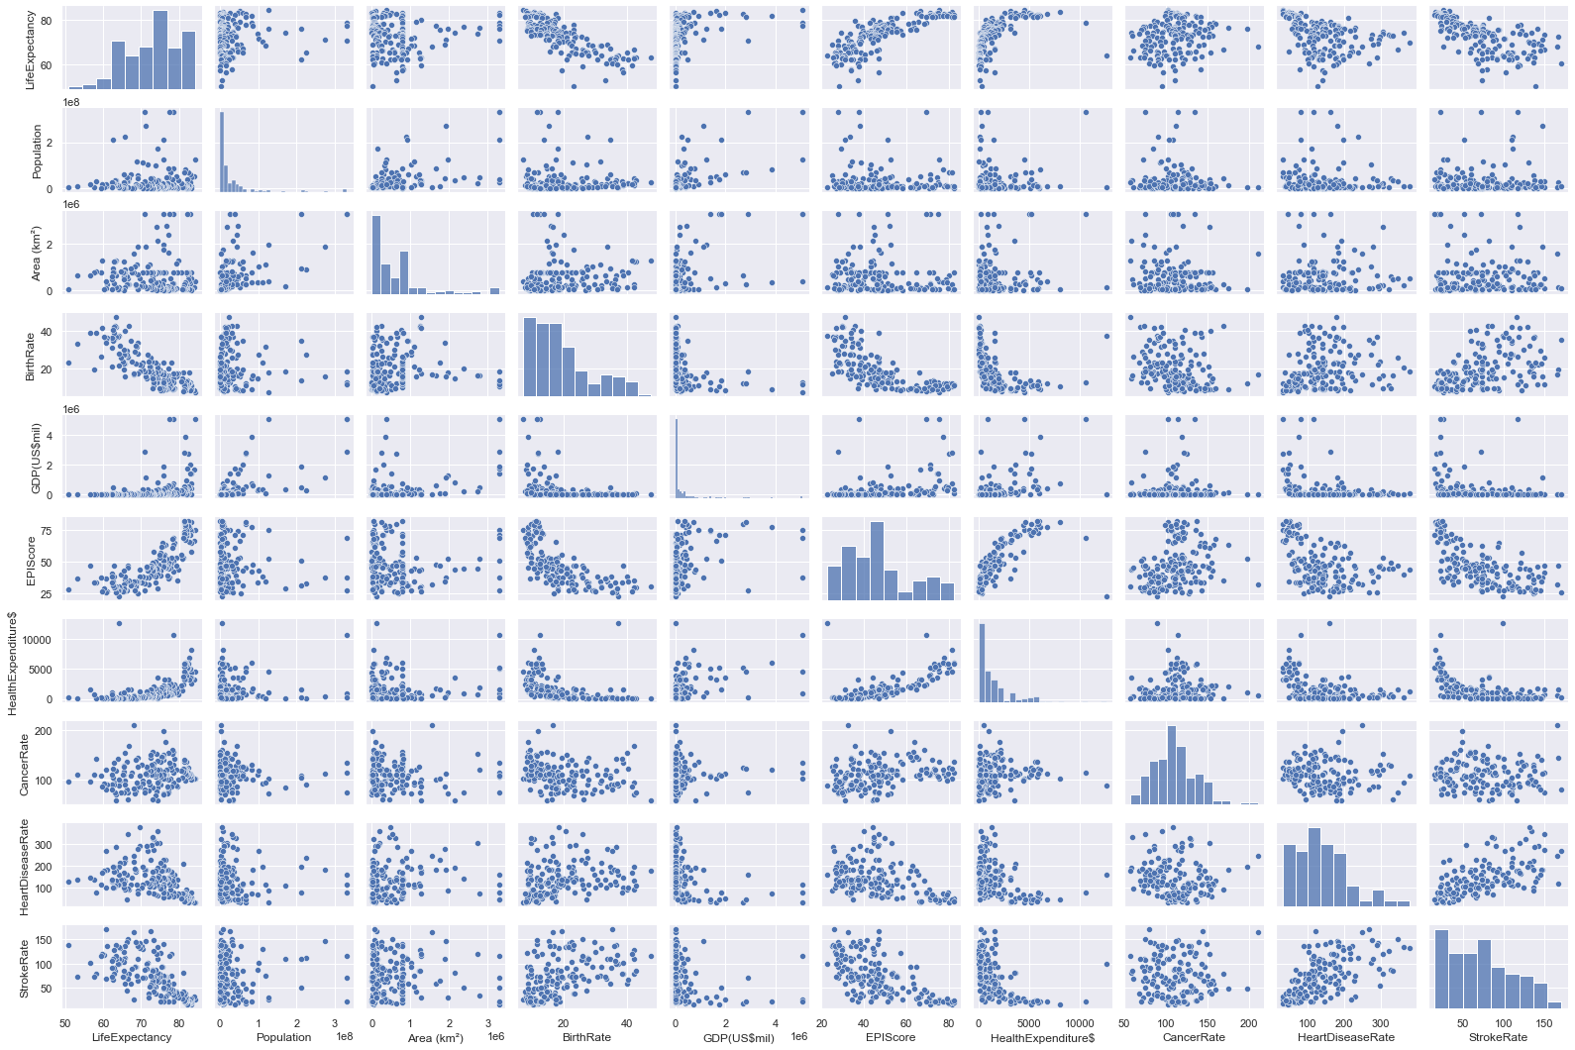
Remove outliers Replace each outlier by next highest value
With Outliers
Replacing with next highest value

Slide 8
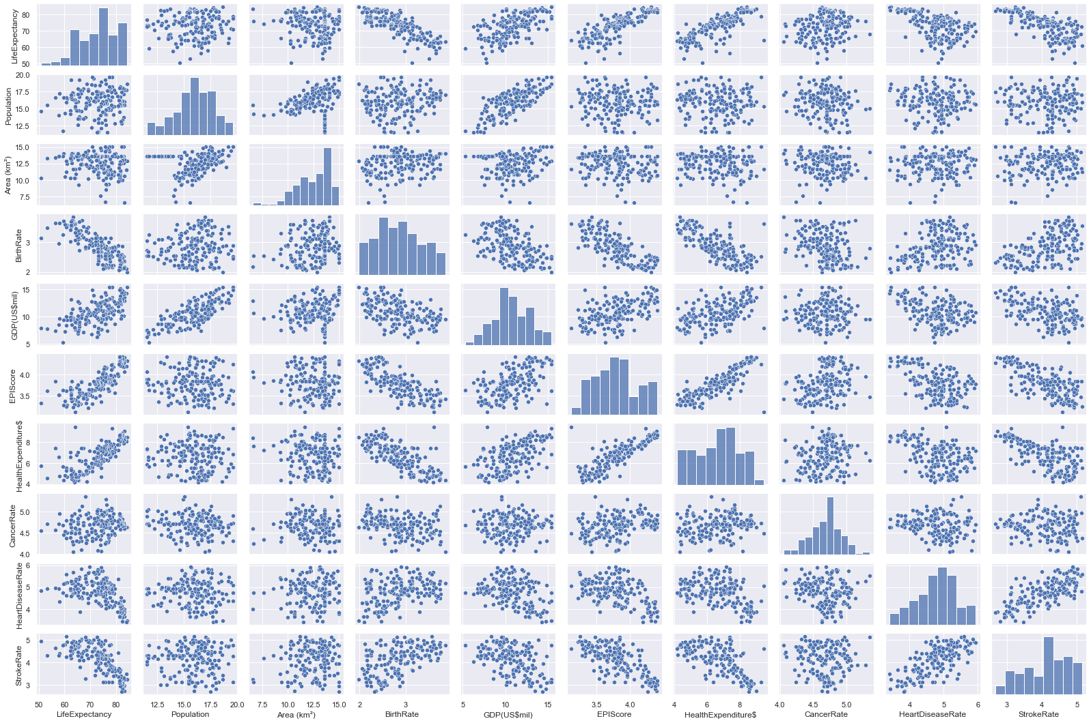
Remove Outliers – 2nd way The original plots are skewed to the right (ie, points are very concentrated on the left side) Apply LOG function to spread data to the right
With Outliers
Applying log function to all features

Slide 9
Linear regression for Feature selection
All features included, R^2 = 0.796
Excluding Birth Rate, R^2 = 0.679 (=> significant feature)
Excluding Cancer Rate, R^2 = 0.794
Excluding EPI, R^2 = 0.771 (=> significant feature)
Excluding GDP, R^2 = 0.795
Excluding Health Expenditure, R^2 =0.795
Excluding Heart Disease Rate, R^2 = 0.795
Excluding Population, R^2 = 0.792
Excluding Area, R^2 = 0.796
Excluding Stroke Rate, R^2 = 0.777 (=> significant feature)

Slide 10
Feature Selection- log function
 | P value
BirthRate | 0.000
CancerRate | 0.532
EPIScore | 0.019
GDP(US$mil) | 0.009
HealthExpenditure$ | 0.689
HeartDiseaseRate | 0.017
Population | 0.123
Area (km²) | 0.000
StrokeRate | 0.003
The highlighted features are
selected for model building.

Slide 11
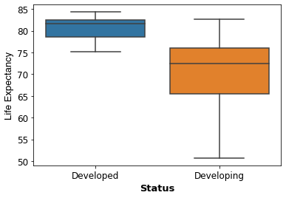
Life expectancy by country development status

Slide 12
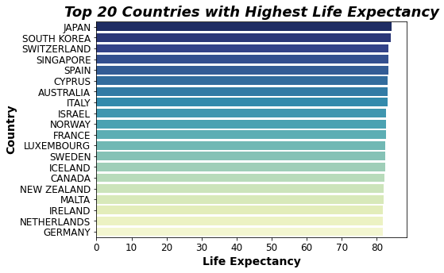
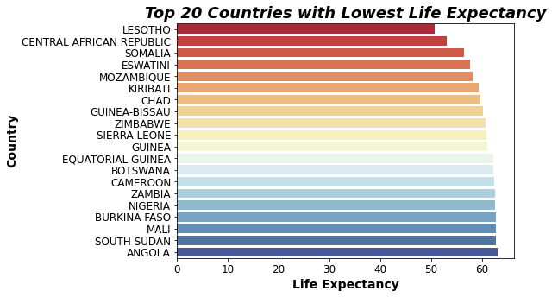
Countries with highest and lowest life expectancy

Slide 13
Model Selection
Model 1: Linear regression
Linear Regression models the relationship between a dependent variable (Y) and one or more independent variables (X) using a best fit straight line (also known as regression line).
Model2: Ridge Regression
This reduces model complexity while keeping all coefficients in the model, known as L2 penalty .
Model3: LASSO Regression
Least Absolute Shrinkage and Selection Operator(LASSO) reduces model complexity by penalizing model coefficients to zero, i.e., L1 penalty .

Slide 14
Model Performance with selected features
Linear regression R^2 : 0.80543
Ridge regression R^2 : 0.79584
Lasso regression R^2 : 0.79552
Potential model
Cross Validation using KFold
Linear regression cv R^2: 0.787 +- 0.026
Ridge regression cv R^2: 0.786 +- 0.026
Lasso regression cv R^2: 0.786 +- 0.026
Selected Model

Slide 15
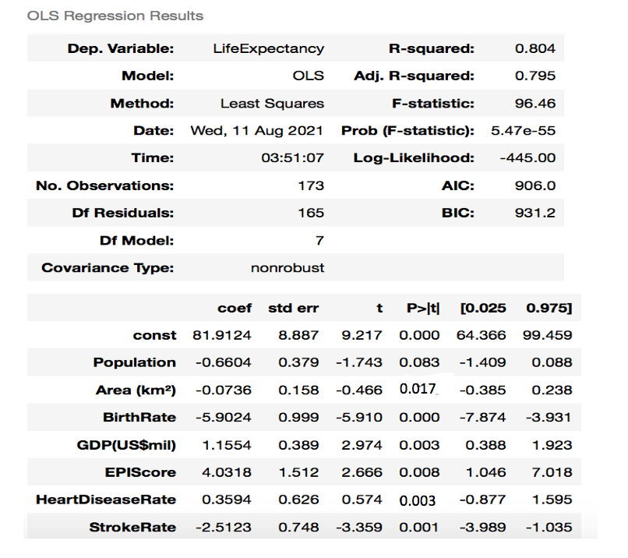
Final model Statistics & Interpretation
If your country has low birth rate, add 6 more years to your life.
If the EPI (Environment Performance Index) is high, add 4 more years to your life.
If you live in a rich country, add a year to your life.
Finally for every unit (or rather LOG unit) decrease in stroke rate, 2 and half more years could be added to your life.

Slide 16
Risk
There are chances for high data discrepancy as in many countries most of these details are not correctly documented.
Getting the right data will help me arrive at the correct outcome.

Slide 17
Next Steps
To collect more data, possible to expand scope to cities instead of countries
To expand scope to include more features (factors)
To split into life expectancy for males and females

Slide 18
Conclusion
The analysis aimed at choosing the relevant factors that affects the life expectancy.
Japan has the highest life expectancy (84.3 years), Lesotho (52 years) and many countries in the African continent are at the bottom of scale.
The implications of the analysis would be that the countries can work on factors that highly influence the life expectancy and improve the factors for better longevity.

Slide 19
References
https://en.wikipedia.org/wiki/List_of_countries_by_life_expectancy
https://en.wikipedia.org/wiki/List_of_countries_and_dependencies_by_population
https://en.wikipedia.org/wiki/List_of_countries_by_GDP_(nominal)
https://en.wikipedia.org/wiki/List_of_sovereign_states_and_dependent_territories_by_birth_rate
https://en.wikipedia.org/wiki/Environmental_Performance_Index
https://en.wikipedia.org/wiki/List_of_countries_by_total_health_expenditure_per_capita
https://www.worldlifeexpectancy.com/cause-of-death/all-cancers/by-country/
https://www.worldlifeexpectancy.com/cause-of-death/coronary-heart-disease/by-country/
https://www.worldlifeexpectancy.com/cause-of-death/stroke/by-country/

